Slide 1
TATA ONLINE RETAIL SALES
(INFOSYS SPRINGBOARD INTERNSHIP)
GUIDED BY
Prof.ARUN K.

Slide 2

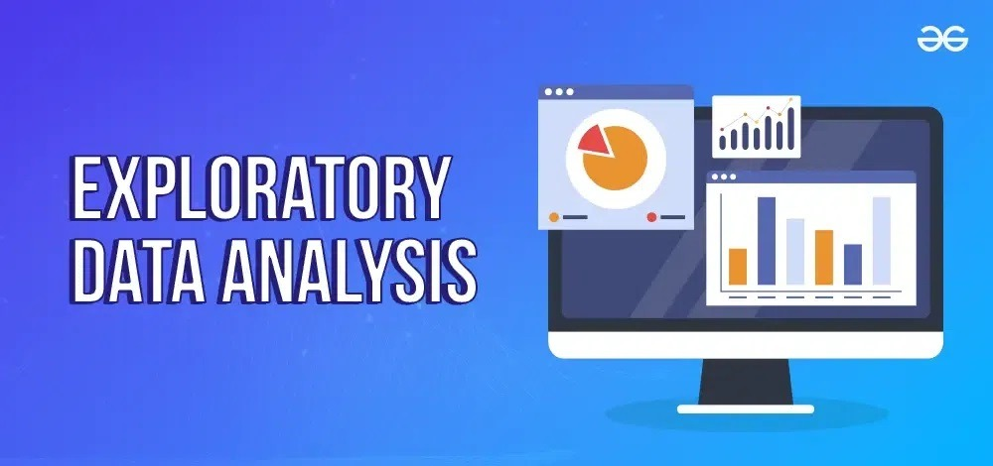

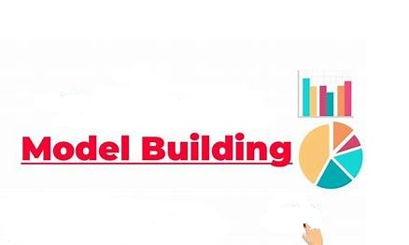
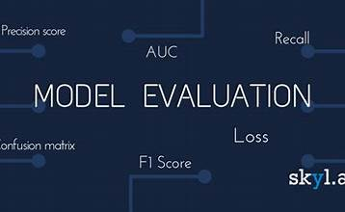

TATA ONLINE RETAIL SALES
Project Workflow:
EDA & DATA CLEANING
FEATURE ENGINEERING
Process of identifying and fixing errors in a dataset.and
an analysis approach that identifies general patterns in the data
MODEL BUILDING & EVALUATION
technique that transforms raw data into a more effective set of inputs for machine learning models
BUSINESS RECOMMENDATION
Model building is the process of transforming data into predictions and insights, while model evaluation is the process of assessing a model's performance
is a recommendation for a company's products or services to another business or person

Slide 3
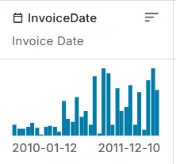
Analysis of the Situation An in-depth evaluation of the current business situation
The dataset spans 12 Jan 2010 to 10 Dec 2011, covering sales, customer demographics, and marketing metrics. The store lacks insights into revenue drivers, marketing effectiveness, and demographic trends. The goal is to analyze data and provide actionable strategies for growth and optimization.
Current Situation Analysis
The online retail store aims to analyze data for strategic planning and revenue growth.
Challenges:
Limited insights into revenue drivers by product, region, and customer segments.
Insufficient analysis of marketing effectiveness (customer acquisition, retention).
Need for demographic-based metrics for tailored strategies.
Goal: To provide actionable insights for improving business performance and guiding strategic decisions.

Slide 4
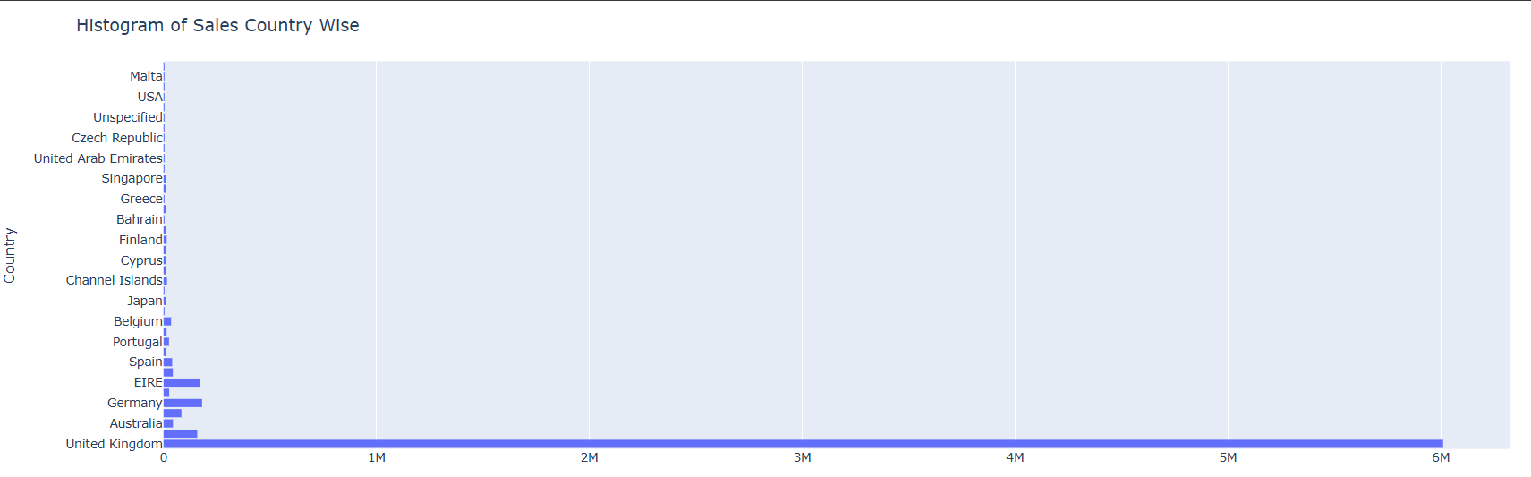
Geographic Insights:
Insights:
Since the company is UK based, United Kingdom has the highest total sales, significantly outperforming all other countries. Other countries, such as Netherlands, EIRE, and Poland, show minimal contributions to total sale
Recommendations:
Focus more resources (marketing, inventory, and customer engagement) in the UK as it drives the majority of revenue. Explore strategies to boost sales in low-performing countries, such as targeted promotions or localized campaigns.

Slide 5
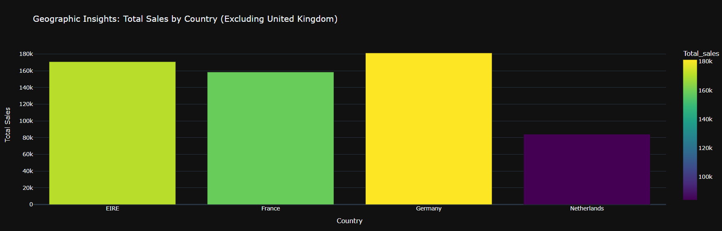
Geographic Insights:
These are the Foreign sales which generates the most revenue and are ready for expansion.
EIRE
France
Germany
Netherlands
Prioritize targeted marketing strategies and localized campaigns in EIRE, France, Germany, and the Netherlands to maximize their revenue potential. Additionally, consider expanding infrastructure and distribution networks in these regions to capitalize on their readiness for growth.

Slide 6
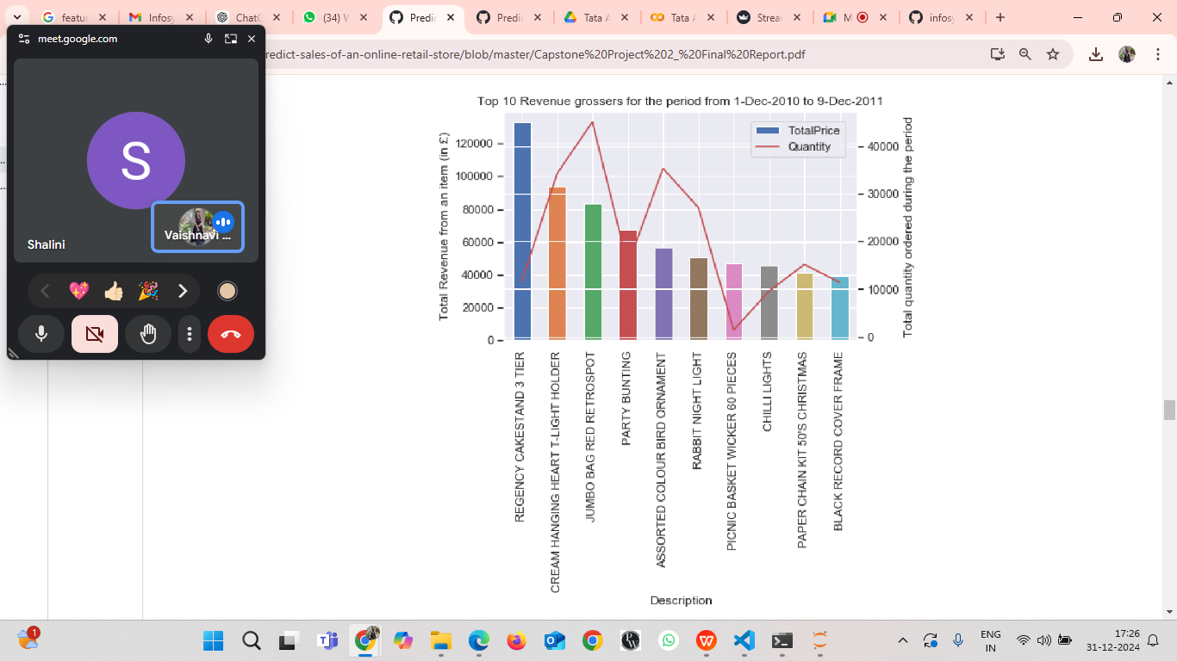
Top popular products:
Observations
1. The best selling products vary in their average unit price. So it doesn’t seem to have any relation with its price.
2. The No. 1 best selling product sells almost double the quantity of the 10th best seller.
3. The no. 1 revenue grosser leads its immediate follower by 26%
Pareto Principle (80-20 rule)
Observations
1. Pareto principle holds true for items in our dataset, as 22% of all the items are
contributing to 80% of the sales revenue. 22% of all items means 803 items.
2. 27% of all the customers are contributing to 80% of the sales revenue. 27% of all
items means 1176 items

Slide 7
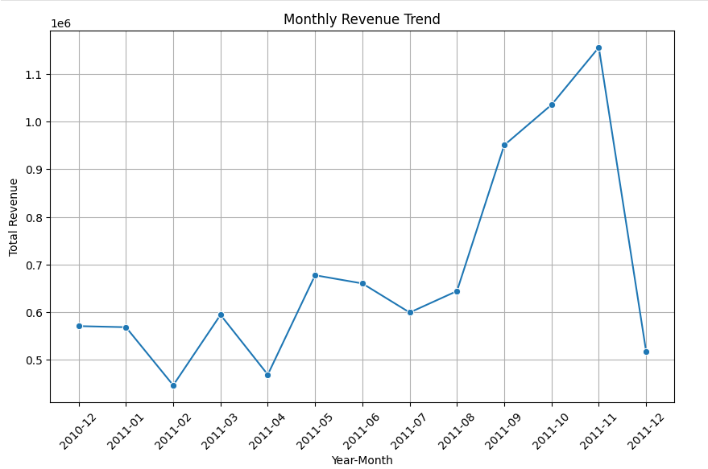
Revenue Trends Analysis
Revenue trends indicate a significant upward trajectory starting from mid-year 2011, peaking in November, followed by a sharp drop in December. Understanding these trends is crucial for optimizing business strategies during high and low-demand periods.
Key Insights:
The revenue significantly increases mid-2011, peaking in November 2011.
Indicates strong sales performance during certain months.
The sharp decline in December suggests seasonal variations or operational issues.
Points to potential bottlenecks or reduced demand.
Revenue trends emphasize the importance of leveraging peak periods for maximum gain.
Capitalizing on high-performing months is critical for business growth.
Recommendations:
Strategize promotional campaigns for high-performing months.
Align efforts with months showing increased revenue.
Investigate and address factors leading to the December decline.
This could involve supply chain analysis or adjusted pricing strategies.
Develop contingency plans for potential dips to maintain stability.
Ensures consistent revenue streams even during low periods.

Slide 8
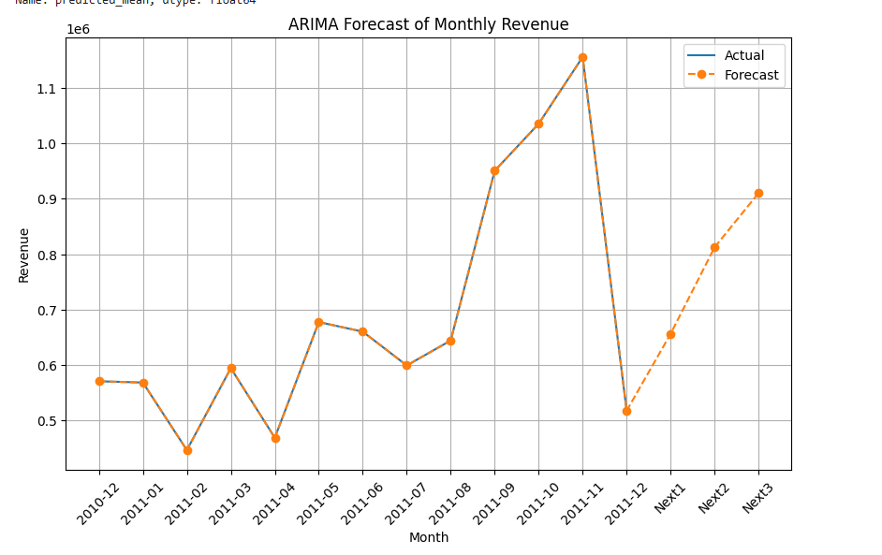
ARIMA Time Series Forecasting
Explanation:
ARIMA (Auto-Regressive Integrated Moving Average) is used to predict monthly revenue trends by analyzing historical data patterns. The model identifies seasonality and growth trends, providing insights into future performance. This allows businesses to make data-driven decisions for resource allocation and marketing.
Key Insights:
Revenue shows seasonal patterns with recovery and growth trends post-dips.
This highlights the importance of understanding seasonal dynamics for strategic planning.
The ARIMA model reliably aligns with actual historical data.
High alignment ensures the forecast's credibility for decision-making.
Forecasting helps identify potential peak periods for targeted actions.
Enables businesses to capitalize on revenue opportunities during high-demand periods.
Recommendations:
Use forecasts to optimize inventory and staffing levels during peak and low periods.
Helps avoid overstocking or understaffing issues.
Align marketing campaigns with projected peak revenue months.
Ensures maximum impact during high-demand seasons.
Regularly update the model with new data for improved accuracy.
Keeps forecasts relevant to changing trends.

Slide 9
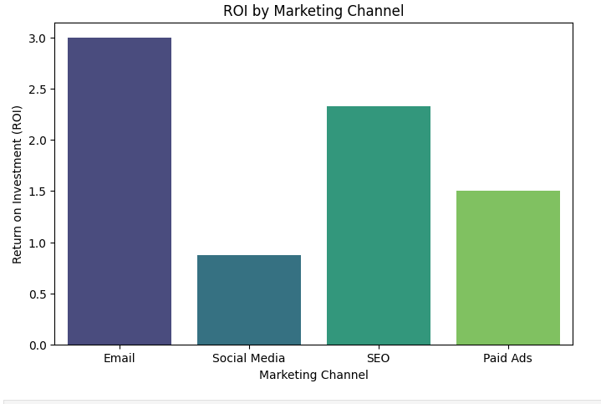
ROI by Marketing Channel
Explanation:
Analyzing ROI (Return on Investment) across marketing channels helps determine the effectiveness of each channel in driving profitability. Channels like Email Marketing and SEO have higher returns, whereas Social Media and Paid Ads require strategic adjustments to enhance their performance.
Key Insights:
Email Marketing: Delivers the highest ROI (~3x), showing effective engagement.
Indicates strong customer loyalty and cost-effectiveness.
SEO: Provides steady ROI, supporting long-term organic growth.
Demonstrates the value of sustained investment in search visibility.
Social Media & Paid Ads: Lower ROI indicates the need for improved strategies.
Suggests room for optimization to enhance performance.
Recommendations:
Increase investment in Email Marketing and SEO for higher returns.
Capitalize on high-performing channels to boost overall profitability.
Reassess and optimize Social Media and Paid Ads through A/B testing.
Test different approaches to identify what resonates with the audience.
Monitor ROI metrics periodically to adapt and refine strategies.
Ensures marketing efforts remain efficient and impactful.

Slide 10
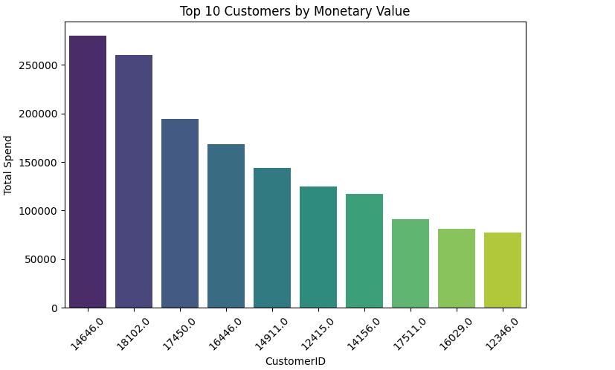
Top Customer Analysis:
Top customers are identified based on their monetary contributions and purchase frequency. Understanding their behavior helps the business prioritize strategies for loyalty and personalized engagement.
Key Insights:
Customer 14646 is the top contributor with consistent high spending.
Indicates a loyal customer base with substantial revenue impact.
High-value customers often exhibit repeat purchase behavior.
Reflects satisfaction with the brand’s offerings.
Concentration of revenue among top customers highlights dependency on a small segment.
Suggests the importance of nurturing this group.
Recommendations:
Develop exclusive loyalty programs for top customers.
Reward consistent contributions with personalized benefits.
Use predictive analytics to anticipate needs and offer tailored recommendations.
Strengthens relationships and encourages repeat purchases.
Diversify revenue streams to reduce dependency on a small customer base.
Ensures sustainable growth and reduces risk.

Slide 11
K-means Clustering Performed for Customer Segmentation
# Normalize RFM data for clustering
from sklearn.cluster import KMeans
scaler = StandardScaler()
rfm_scaled = scaler.fit_transform(rfm_data[['Recency', 'Frequency', 'Monetary']])
# Apply K-Means clustering
kmeans = KMeans(n_clusters=4, random_state=42)
rfm_data['Cluster'] = kmeans.fit_predict(rfm_scaled)
# Visualize clusters
plt.figure(figsize=(8, 6))
sns.scatterplot(x='Recency', y='Monetary', hue='Cluster', data=rfm_data, palette='viridis')
plt.title('Customer Segmentation')
plt.xlabel('Recency')
plt.ylabel('Monetary')
plt.legend(title='Cluster', bbox_to_anchor=(1.05, 1), loc='upper left')
plt.show()

Slide 12
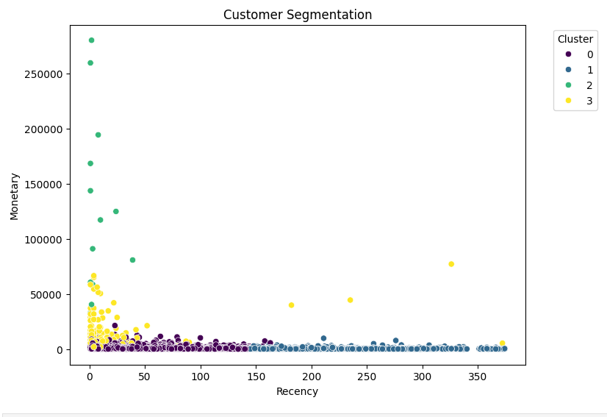
Customer Segmentation Analysis:
Customer segmentation using RFM (Recency, Frequency, and Monetary value) reveals distinct groups. These insights help target strategies for customer retention, reactivation, and upselling.Using Kmeans Clustering we have performed this customer segmentation analysis.
Key Insights:
High-value customers contribute significantly to revenue (e.g., Customer 14646).
2.Cluster 2 (high monetary value, low recency) comprises valuable but at-risk customers.
Cluster 3 (high recency, low monetary value) includes recent but low-spending customers.
Recommendations:
Retain high-value customers with loyalty programs and personalized offers.
Reactivate Cluster 2 with retention campaigns and incentives.
Upsell and cross-sell to Cluster 3 with tailored marketing strategies.

Slide 13
Average Sales Per Day in 2010 and 2011
#for Year 2010
df['Year'] = df['InvoiceDate'].dt.year
df_2010 = df[df['Year'] == 2010]
df_2010['Total_sales'] = df_2010['Quantity'] * df_2010['UnitPrice']
avg_sales_2010 = df_2010.groupby('Day')['Total_sales'].mean().reset_index()
fig_2010 = px.histogram(avg_sales_2010, x="Day", y="Total_sales", title="Average Sales per Day in 2010")
fig_2010.update_layout(xaxis_title="Day", yaxis_title="Average Sales", template="plotly_dark")
fig_2010.show()
#for Year 2011
df_2011 = df[df['Year'] == 2011]
df_2011['Total_sales'] = df_2011['Quantity'] * df_2011['UnitPrice']
avg_sales_2011 = df_2011.groupby('Day')['Total_sales'].mean().reset_index()
fig_2011 = px.histogram(avg_sales_2011, x="Day", y="Total_sales", title="Average Sales per Day in 2011")
fig_2011.update_layout(xaxis_title="Day", yaxis_title="Average Sales", template="plotly_dark")
fig_2011.show()

Slide 14
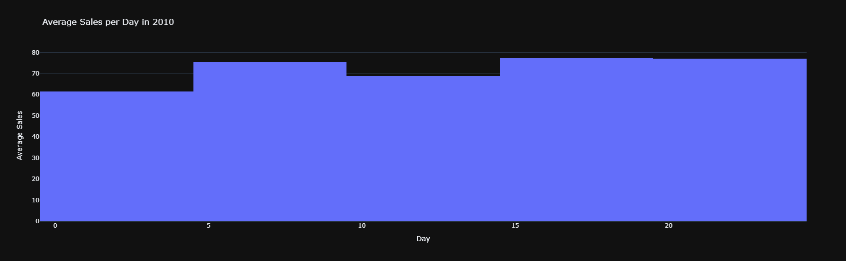
Average Sales Per Day In 2010
Observation: In the year 2010,the sale was mostly high from 15 to 30 dates and also in between 5-10 dates .

Slide 15
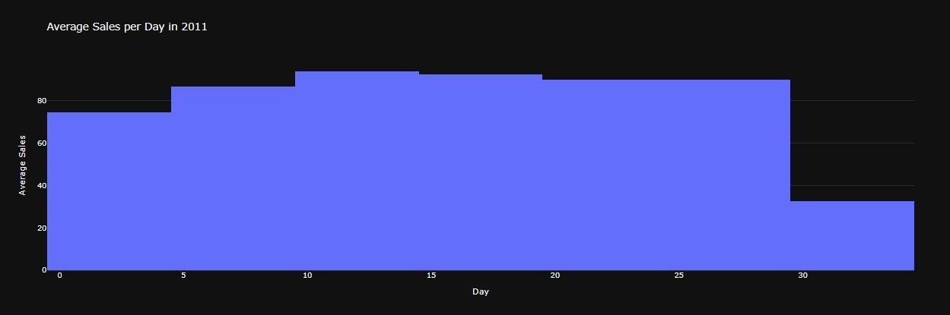
Average Sales Per Day In 2011
Observation: In year 2011, between 10-15 days ,the sales was high then from 15-20 was 2nd higher slot for sales.From the year 2010,sales were increased in the year 2011 everyday.

Slide 16
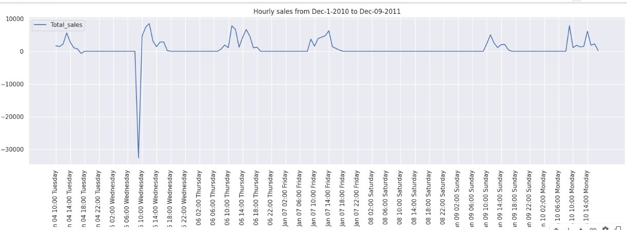
Time- Seires Plots
Observations
1. There is no sales happening on Saturdays.
2. Sales falls down during the holidays
3. There is zero sales happening on Boxing day (Dec 26th) which probably means that
the company does not offer any promotions during the holidays/special days.
4. Sales happens only during the working hours - between 8am and 6pm.
5. There is no particular trend seen in monthly and weekly sales. The overall sales has
increased through the months.

Slide 17
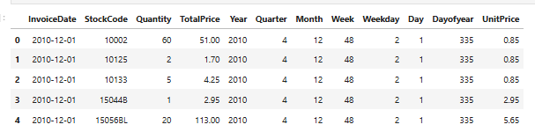
Descriptive and Inferential Statistics :Summary
Statistics:Observations:
● There are some negative values for Quantity and TotalPrice. We drop these observations.
● The maximum value for Quantity and TotalPrice is very high, so we should do outlier analysis to
remove the outliers.

Slide 18
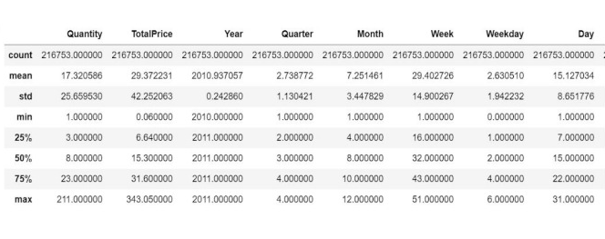
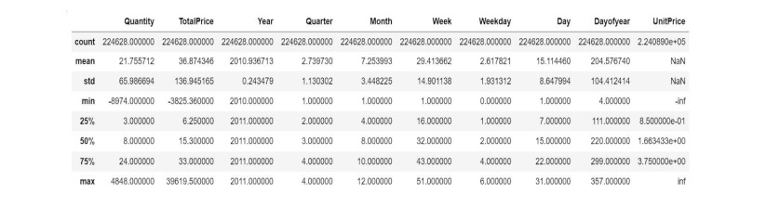
OUTLIER ANALYSIS
We used z-score to identify outliers from Quantity and TotalPrice and
dropped theobservations which are more than 3 standard deviations away.
This is how thesummary statistics looks like after removing outliers.

Slide 19
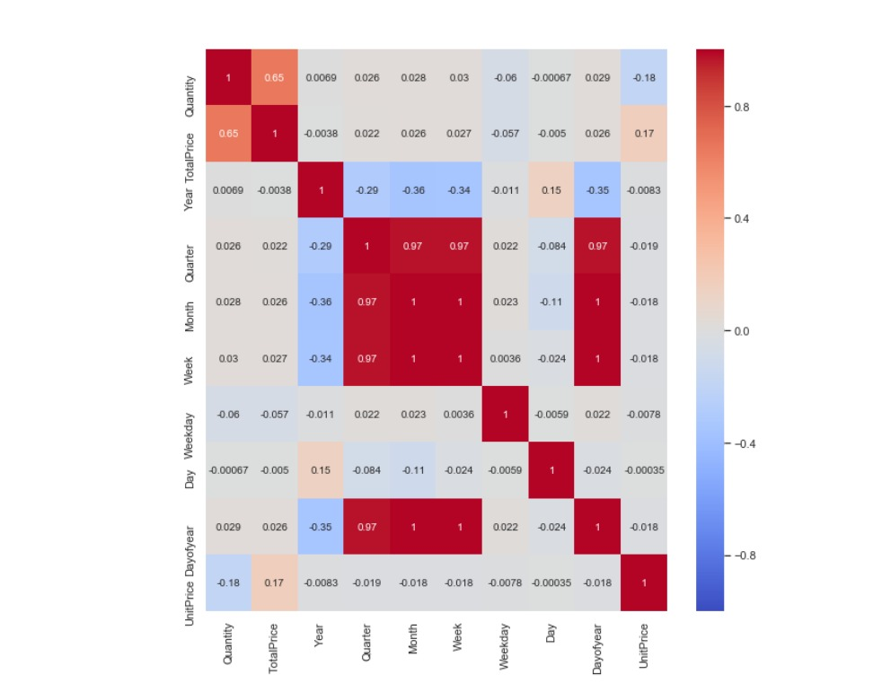
Heatmap Correlation between features
Heatmap observation:
Above heatmap shows strong correlation between Quarter, Month, Dayofyear and Week. We will drop , Dayofyear, quarter and month, and just keep week, as week is most strongly correlated with week. Year has strong correlation with Day, and as it is not strongly correlated with Quantity, we will drop it.

Slide 20
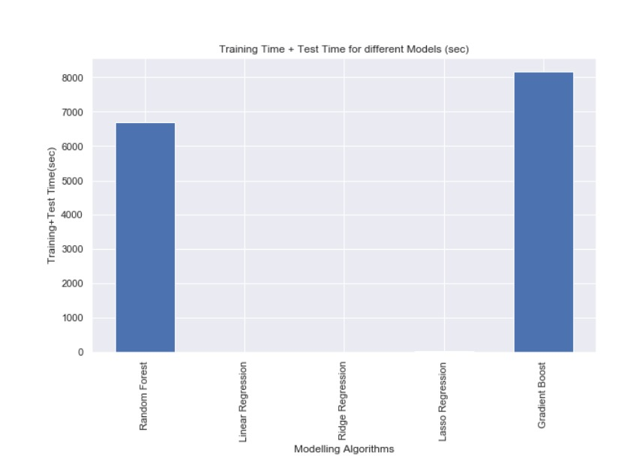
Modeling Algorithm:
As seen in the given graph, Random Forest is taking much lesser time as compared to Gradient Boost. Sowe choose Random Forest as our final algorithm. Random Forest gives an RMSE of 22.7 on our test data.

Slide 21
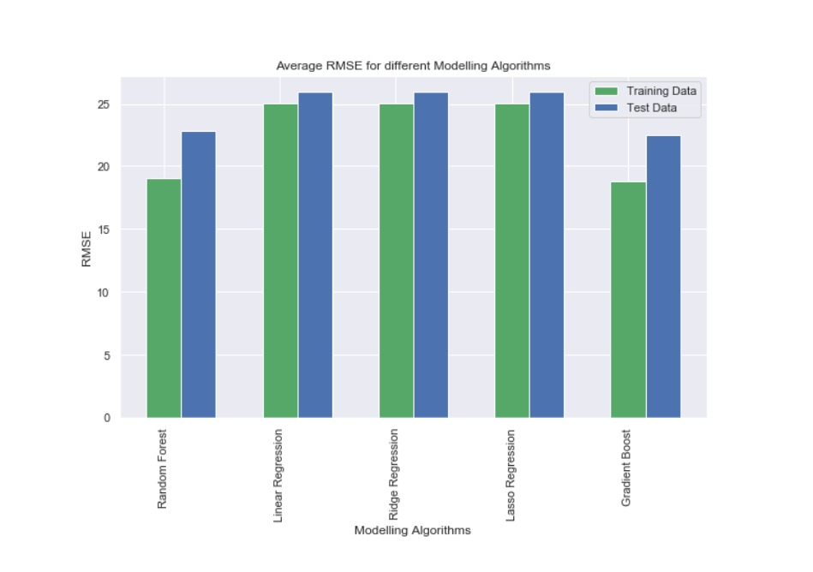
Modeling ALgorithm
Random Forest and Gradient Boost show the best performance on the test dataset. Inorder to decide one of these, we look at the time taken in fitting the model. In all the algorithms, the prediction time was very small in comparison to the fit time.

Slide 22

Streamlit Demo

Slide 23
Any Question?
Thank you

